Slide 1
UTILIZATION OF IMAGES FOR MONITORING OF PROGRESS OF CONSTRUCTION ACTIVITIES FOR BUILDING CONSTRUCTION PROJECTS
CSE7101- Capstone Project
Review-3
Batch Number: ISE_05
Under the Supervision of,
Dr . Zafar Ali Khan
Professor
School of Computer Science and Engineering
Presidency University
Roll Number | Student Name
20221ISE0025 | GAGANA S R
20221ISE0021 | TANUSHREE M S
20221ISE0042 | SNEHA KUMARI
Name of the Program: B. Tech Information Science Engineering(Robotics)
Name of the HoD: Dr. Zafar Ali Khan
Name of the Program Project Coordinator: Ms. Suma N G
Name of the School Project Coordinators: Dr. Sampath A K, Dr. Geetha A

Slide 2
Problem Statement Number: 351
Organization: Ministry of Housing and Urban Affairs
Category (Hardware / Software / Both) :Software
Problem Description : Monitoring the progress of building construction projects is often challenging due to the reliance on manual inspections and subjective reporting, which can lead to delays and errors. By systematically collecting and analyzing images, project managers can create visual progress records, compare actual work with planned schedules, generate quantitative progress metrics, and detect delays or quality issues early. This approach improves transparency, reduces the need for frequent site visits, and enhances decision-making, ultimately leading to more efficient project management.
Expected output: Accurate visual records and measurable insights on construction progress, enabling early issue detection, reduced manual monitoring, and improved project management efficiency
Problem Description:

Slide 3
Content
Abstract
Problem Statement
Objectives
Analysis of Problem Statement
Current Challenges
Opportunities
Novel Contributions
Git-hub Link
Timeline of the Project
References

Slide 4
Abstract
Construction project management faces challenges in efficiently tracking and reporting progress. This paper explores the utilization of images as a powerful tool for monitoring the progress of construction activities in building projects. Traditional methods, often reliant on manual site visits and subjective reporting, are prone to inaccuracies and delays. In contrast, leveraging visual data from sources like drone footage, time-lapse cameras, and mobile devices offers a robust and objective solution. This research investigates various methodologies for image-based progress monitoring, including computer vision and machine learning algorithms, to automatically identify completed tasks, quantify work progress, and detect discrepancies between planned schedules and actual on-site conditions. The study highlights how this approach can enhance project transparency, improve communication among stakeholders, and enable proactive decision-making. The findings demonstrate that integrating image-based monitoring can significantly increase the accuracy and timeliness of progress reports, leading to more efficient project completion and better resource management.

Slide 5
Problem Statement
The main problem is that construction progress monitoring using images is often slow, manual, and prone to errors due to poor image quality and difficult site conditions. Managing and analyzing large amounts of images is hard, and current systems don’t integrate well with project tools, causing communication gaps and delays. There is a need for automated, accurate, and easy-to-use image monitoring systems to improve efficiency and timely decision-making in construction projects.

Slide 6
Objectives
To design and develop a software system that uses site images to monitor and evaluate the progress of construction activities.
To automate the comparison of planned versus actual progress with image data.
To provide visual dashboards and reports for project managers and stakeholders.
To reduce manual effort, errors, and delays in construction monitoring.
To improve decision-making and transparency in construction projects.

Slide 7
Analysis of Problem Statement
Manual and Slow Process
Quality and Site Challenges
Data Management Difficulties
Lack of Integration
Need for Automation

Slide 8
Current Challenges
Manual challenges:
Not Enough Skilled Workers
Projects Taking Longer Than Planned
Going Over Budget
Poor Communication
Slow Use of New Technology
Technical challenges:
Data Acquisition and Environmental Challenges
Data Processing and Integration Challenges
Data Management and Storage Challenges
Security and Ethical Challenges
Business and Operational Challenges

Slide 9
Opportunities with Image Use
Track Progress Easily
Solve Problems Faster
Better Communication
Keep Clear Records
Monitor Remotely

Slide 10
Novel Contributions
Scalable & Extensible – Can be enhanced with AI/ML models for object detection (e.g., detecting completed structural components).
Visual Evidence Reporting – Generates dashboards and reports enriched with visual proof (before/after images).
Automated Progress Tracking – Uses image processing to automatically compare site progress with planned schedules.
Affordable & Accessible – Unlike high-cost BIM or drone solutions, the system is designed as a low-cost software tool accessible to small and medium construction firms.

Slide 11
Software Details:
Programming Languages: Python (Backend), JavaScript (Frontend).
Libraries: OpenCV, TensorFlow/PyTorch for deep learning, Pandas for data analysis.
Database: PostgreSQL for structured data and MongoDB for unstructured image metadata.
Integration: Autodesk Forge API for BIM data access.

Slide 12
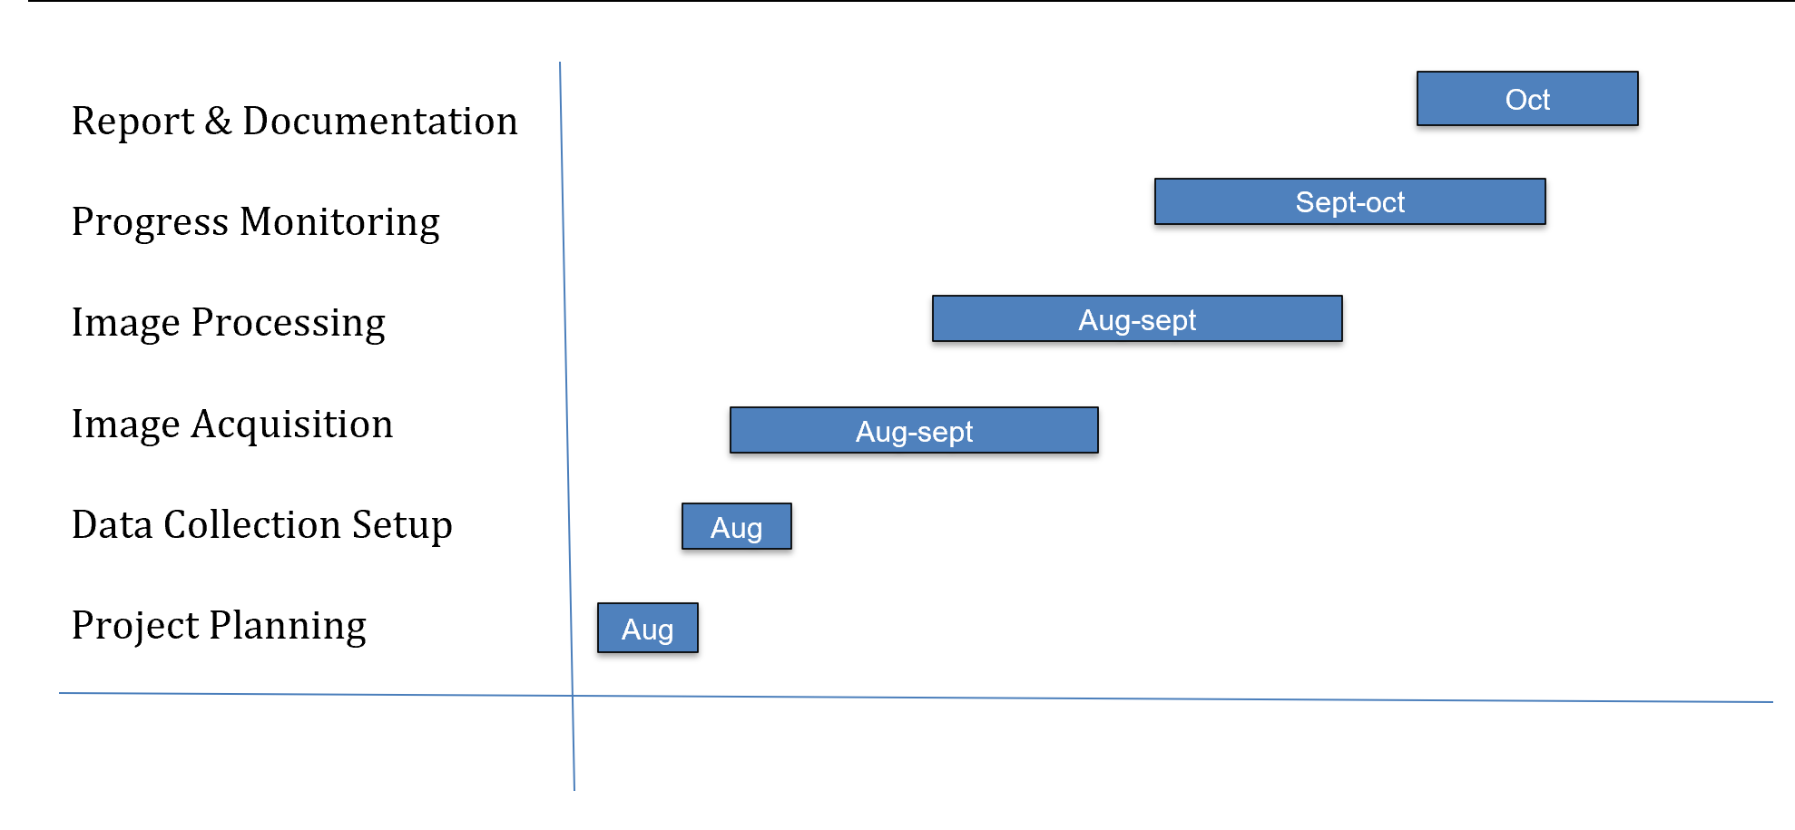
Timeline of the Project (Gantt Chart)

Slide 13
Github Link
https://github.com/Tanushreems/Utilization-of-images-for-monitoring-of-progress-of-construction-activities.git

Slide 14
References (IEEE Paper format)
[1] M. Golparvar-Fard, F. Pena-Mora, and C. A. Arboleda, “Construction performance monitoring via still images, time-lapse photos, and video streams: Now, tomorrow, and the future,” Automation in Construction, 2012. [Online]. Available: https://www.sciencedirect.com/science/article/abs/pii/S1474034615000233
[2] R. Zheng, J. Liu, and Y. Xu, “Review of Image-Based 3D Reconstruction of Building for Automated Construction Progress Monitoring,” Applied Sciences, 2021. [Online]. Available: https://www.mdpi.com/2076-3417/11/17/7840
[3] B. Ekanayake and L. S. Marasinghe, “Automated Computer Vision-Based Construction Progress Monitoring: A Systematic Review,” Buildings, 2022. [Online]. Available: https://www.mdpi.com/2075-5309/12/7/1037
[4] B. Ekanayake and L. S. Marasinghe, “Construction Progress Monitoring and Reporting using Computer Vision Techniques – A Review,” ISARC, 2022. [Online]. Available: https://www.iaarc.org/publications/fulltext/062_ISARC%202022_Paper_48.pdf
[5] M. Golparvar-Fard, S. Bohn, and F. Pena-Mora, “Visualization of Construction Progress Monitoring with 4D Simulation Model Overlaid on Time-Lapsed Photographs,” Journal of Computing in Civil Engineering, 2009. [Online]. Available: https://www.researchgate.net/publication/228662339
[6] Z. Jiang, “Automated Construction Progress Monitoring using Image Segmentation and Building Information Models,” Pennsylvania State Univ. Dissertation, 2023. [Online]. Available: https://etda.libraries.psu.edu/catalog/19715zpj5026
[7] W. Wei, et al., “Integrated vision-based automated progress monitoring of indoor construction using mask region-based convolutional neural networks and BIM,” Automation in Construction, 2022. [Online]. Available: https://www.sciencedirect.com/science/article/abs/pii/S092658052200200X
[8] A. Braun, et al., “BIM-based progress monitoring,” Automation in Construction, 2017. [Online]. Available: https://www.academia.edu/44587691/BIM_based_progress_monitoring
[9] C. C. Hsieh, et al., “Integration of Construction Progress Monitoring Results using AI Image Recognition from Multiple Cameras onto a BIM,” ISARC, 2024. [Online]. Available: https://www.iaarc.org/publications/2024_proceedings...
[10] A. S. Greeshma and R. B. Edayadiyil, “Computer Vision for Construction Progress Monitoring: A Real-Time Object Detection Approach,” arXiv preprint, 2023. [Online]. Available: https://www.researchgate.net/publication/374014867
[11] A. S. Greeshma and R. B. Edayadiyil, “Automated progress monitoring of construction projects using Machine learning and image processing approach,” Materials Today: Proceedings, 2022. [Online]. Available: https://www.sciencedirect.com/science/article/abs/pii/S2214785322014602
[12] M. Bonyani and M. Soleymani, “Towards Improving Workers' Safety and Progress Monitoring of Construction Sites Through Construction Site Understanding,” arXiv preprint, 2022. [Online]. Available: https://arxiv.org/abs/2210.15760
[13] B. Ekanayake and L. S. Marasinghe, “Deep learning-based computer vision in project management: Automating indoor construction progress monitoring,” Project Leadership and Society, 2024. [Online]. Available: https://www.sciencedirect.com/science/article/pii/S2666721524000346
[14] A. Pal, J. J. Lin, S. H. Hsieh, and M. Golparvar-Fard, “Automated Vision-Based Construction Progress Monitoring in Built Environment through Digital Twin,” Developments in the Built Environment, vol. 16, Article 100247, 2023. [Online]. Available: https://www.sciencedirect.com/science/article/pii/S2666165923001291
[15] W. Jung and Y. Kang, “Automated progress measurement using a novel image recognition method for civil engineering applications,” Automation in Construction, 2014. [Online]. Available: https://www.academia.edu/17128808

Slide 15


